Slide 1
Business Plan

Slide 2
Business Plan- Introduction
A business plan is crucial for intending to start a new business venture, or established businesses that want to expand
A business plan provides a complete description of a business, explaining its products or services, marketing and sales strategies, the management team, operations and predictions of financial forecasts.
The business plan, therefore, enables a business idea to be taken from the initial conception stage towards a fully reasoned and realistic plan of action.

Slide 3
Scope and Value of the Business Plan?
The business plan may be read by employees, investors, bankers, suppliers, customers, advisors and consultants.
The business plan is valuable because it:
Helps determine the viability of the venture in a designated market.
Guides the entrepreneur in organizing planning activities.
Serves as an important tool in obtaining financing.
Essentially a guide to what your business will do, what you aim to achieve, how you will accomplish this and whether you have the ability to do so.

Slide 4
A way to formalize, structure and therefore assess the viability of your ideas.
Businesses should use the plan to guide decision making and it should be reviewed, modified and developed as the business progresses and evolves.
Businesses that implement their business plan and keep it up-to-date are able to monitor their growth and are in a better position to seek out external funding to assist with future developments.

Slide 5
Structure of the Business Plan
A business plan encompasses various sections that allow the reader to follow a logical format and structure.
It should be comprehensive enough to give any potential investor a complete picture and understanding of the new venture and will help the entrepreneur clarify his/her concept about the business.

Slide 6
The most commonly used sections are as follows:
Introductory Page
Executive Summary
Industry/Environment Analysis
Description of the Venture
Operations/Production Plan
Marketing Plan
Organizational Plan (structure of ownership)
Assessment of Risk
Financial Plan
Appendix

Slide 7
Writing the Business Plan
1.Introductory Page
Name and address of the company.
Name of the entrepreneur(s), telephone number, fax number, e-mail address, and Web site address.
Description of the company and nature of the business.
Statement of financing needed.
Statement of confidentiality of report.

Slide 8
2. Executive Summary
About two to three pages in length summarizing the complete business plan.
3. Environmental and Industry Analysis
The environmental analysis assesses external uncontrollable variables that may impact the business plan.
Examples: Economy, culture, technology, legal concerns, etc.
The industry analysis involves reviewing industry trends and competitive strategies.
Examples: Industry demand, competition, etc.

Slide 9
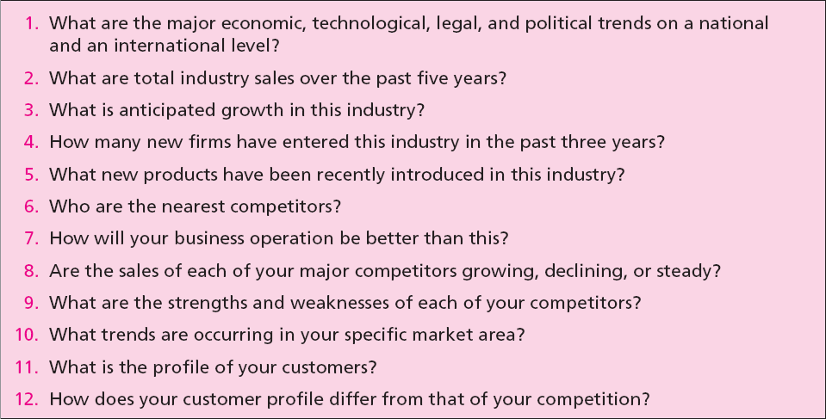
Critical Issues for Environmental and Industry Analysis

Slide 10
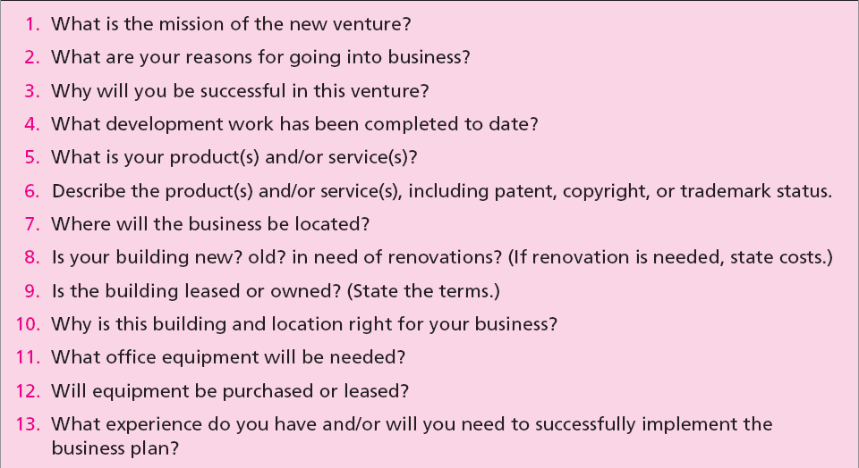
4. Describing the Venture

Slide 11
5. Operations/Production Plan
All businesses (manufacturing or nonmanufacturing) should include an operations plan as part of the business plan.
It goes beyond the manufacturing process.
Describes the flow of goods and services from production to the customer.
The major distinction between services and manufactured goods is services involve intangible performances.

Slide 12
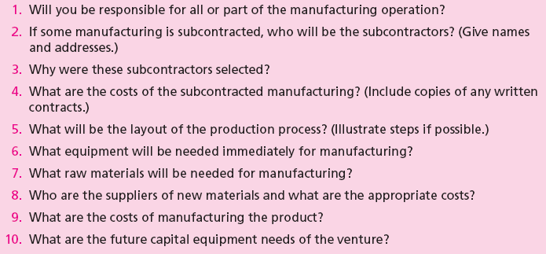
Critical Issues for Operational Plan

Slide 13
6. Marketing Plan
It describes market conditions and strategy related to how the product/service will be distributed, priced, and promoted.
Marketing research evidence to support any of the marketing decision strategies as well as for forecasting sales should be described in this section.
Potential investors regard the marketing plan as critical to the success of the new venture.

Slide 14
7. Organizational Plan
It describes the form of ownership and lines of authority and responsibility of members of new venture.
In case of a partnership, the terms of the partnership should be included.
In case of a corporation, the following should be included:
Shares of stock authorized and share options.
Names, addresses, and resumes of directors and officers.
Organization chart.

Slide 15
8. Assessment of Risk
Identifies potential hazards and alternative strategies to meet goals and objectives.
The entrepreneur should indicate:
Potential risks to the new venture.
Impact of the risks.
Strategy to prevent, minimize, or respond to the risk.
Major risks could result from:
Competitor’s reaction.
Weaknesses in marketing/ production/ management team.
New advances in technology.

Slide 16
9. Financial Plan
It contains projections of key financial data that determine economic feasibility and necessary financial investment commitment.
It should contain:
Summarized forecasted sales and appropriate expenses for at least the first three years.
Cash flow figures for three years.
Projected balance sheet.

Slide 17
10. Appendix
It contains any backup material that is not necessary in the text of the document.
It may include:
Letters from customers, distributors, or subcontractors.
Secondary data or primary research data used to support plan decisions.
Leases, contracts, or other types of agreements.
Price lists from suppliers and competitors.

Slide 18
The Marketing Plan
Purpose and Timing of the Marketing Plan
The marketing plan establishes how the entrepreneur will effectively compete and operate in the marketplace.
Marketing planning should be an annual activity focusing on decisions related to the marketing mix variables.

Slide 19
Understanding the marketing plan
The marketing plan should answer three basic questions:
Where are we?
-The history of the marketplace, marketing strengths and weaknesses, and market opportunities.
Where do we want to go (short term)?
- Marketing objectives and goals in the next twelve months.
How do we get there?
-Specific marketing strategy that will be implemented.

Slide 20
MARKET RESEARCH FOR THE NEW VENTURE
Information for developing the marketing plan may require some marketing research.
Marketing research involves
gathering of data in order to determine
who will buy the product,
what price should be charged, and
what is the most effective promotion strategy.

Slide 21
MARKET RESEARCH
Defining the Purpose or Objectives
Gathering Data from Secondary Sources
trade magazines,
libraries,
government agencies, and
The Internet
3. Gathering Information from Primary Sources
Observation
Networking
Interviewing or surveying
4. Analyzing and Interpreting the Results

Slide 22
STEPS IN PREPARING THE MARKETING PLAN
Step 1: Defining the Business Situation
Step 2: Defining Target Market/Opportunities and Threats
Step 3: Considering Strengths and Weaknesses
Step 4: Establishing Goals and Objectives
Step 5: Defining Marketing Strategy and Action Programs
Step 6: Coordination of the Planning Process
Step 7: Designing Responsibility for Implementation
Step 8: Budgeting the Marketing Strategy
Step 9: Implementation of the Marketing Plan
Step 10: Monitoring Progress of Marketing Actions

Slide 23
Why Some Business Plans Fail
Goals are unreasonable.
Objectives are not measurable.
Entrepreneur has not made a total commitment to the business or to the family.
Lack of experience in the planned business.
No sense of potential threats or weaknesses to the business.
No customer need was established for the proposed product or service.

